Slide 1




Network vulnerabilities
INGI2347: COMPUTER SYSTEM SECURITY (Spring 2014)
Marco Canini
Lecture slides adapted from UCL INGI2347 by Gildas Avoine and Upenn CSE331 by Steve Zdancewic Reproduced with permission
Notes:
Image source: http://www.itproportal.com/

Slide 2
Announcements
In-class exercises on 10 & 11 Feb
Starting 10 Feb, Mondays class moved to BARB 13
First challenge announced at the end of this lecture

Slide 3
Plan for today
Lecture 3
Network basics
Spoofing
Sniffing
Session Hijacking
Denial of Service (DoS)
NEXT

Slide 4
DARPA Internet Design Goals
“to develop an effective technique for multiplexed utilization of existing interconnected network” – D. Clark, The Design Philosophy of the DARPA Internet Protocols
Secondary goals:
Tolerate loss of networks or gateways
Support multiple types of communications service
Accommodate a variety of networks
Permit distributed management of its resources
Be cost effective
Permit host attachment with a low level of effort
Used resources must be accountable
Primarily designed for a benign and trustworthy environment

Slide 5
Layering
A result of abstraction in network design
Higher level services are implemented by using services at lower levels
Advantages
Decompose problems
Modular changes
TCP/IP Layered Model | OSI Layered Model
Application (e.g. SMTP, HTTP, Telnet) | Application
 | Presentation
 | Session
Transport (e.g. TCP, UDP) | Transport
Internet (e.g. IP, ARP, ICMP) | Network
Link (e.g. Ethernet, PPP, X25) | Data Link
 | Physical

Slide 6
Data Flow
process-to-process
Application
Application
host-to-host
Transport
Transport
Internet
Internet
Internet
Internet
Link
Link
Link
Link
Ethernet
Fiber
Ethernet

Slide 7
Recall IP
How does the router know where to forward a packet?
IP adopts a datagram approach
Every packet (datagram) contains the destination IP address
Packets can be sent at anywhere at any time
Best-effort delivery (unreliable)

Slide 8
Recall IP
0 4 8 16 19 31
Version | Hlen | TOS | Length
Identification |  |  | Flags | Offset
Time to Live |  | Protocol | Checksum
Source Address
Destination Address
Options (variable length) |  |  |  |  | Pad
Can you trust the contents?

Slide 9
Recall UDP
0 16 31
Source Port | Destination Port
Length | Checksum
Minimal message-oriented transport protocol
Provide no guarantees for message delivery
Port numbers to perform application demultiplexing
e.g., port 53 is DNS, port 2049 is NFS, port 138 is Netbios

Slide 10
Recall TCP
0 16 31
Source Port |  |  | Destination Port
Sequence Number
Acknowledgment Number (if ACK set)
Data Offset | 0 | Flags | Window Size
Checksum |  |  | Urgent Pointer (if URG set)
Options (variable length) |  |  |  | Pad
Reliable, in-order message delivery
Sequence numbers identify the order of the bytes sent
Ack number specify the sequence number of the next expected byte
Sliding window flow control to not overflow receiver

Slide 11
TCP Connection Establishment
3-way handshake: SYN ; SYN + ACK ; ACK
client
server
flags = (SYN) seq=x
flags = (SYN,ACK) seq=y ack=x+1
flags = (ACK) seq=x+1 ack=y+1

Slide 12
TCP Connection Termination
initiator
receiver
flags = FIN
flags = ACK
flags = FIN
flags = ACK
Each side of the connection terminates independently
A connection can be “half-open”, in which case one side has terminated, but the other has not

Slide 13
Recall ARP (Address Resolution Protocol)
Problem:
need mapping between IP addresses and hardware addresses
Solution: ARP
Every host maintains IP-HW address mapping table (cache)
Timeout associate with cached info (15 min)
Sender
Broadcasts “Who is IP address X?”
Broadcast message includes sender’s IP and HW addresses
Receivers
Any host with sender in cache “refreshes” timeout
Host with IP address X replies “IP X has HW address Y”
Target host adds sender (if not already in cache)

Slide 14
Spoofing

Slide 15
IP Spoofing
Many TCP/IP suite protocols do not authenticate the source or destination of a message
An attacker can forge a packet’s source IP address and abuse the trust of that source
E.g., routers and firewalls can filter packets according to their source
E.g., certain programs (rlogin, rsh) grant access based on IP address

Slide 16
IP Spoofing Example
Internet
Real IP: 1.1.1.1
Attacker
Router
Source (spoofed): 3.3.3.3 Destination: 2.2.2.2
Spoofed Host
Victim
IP: 3.3.3.3
IP: 2.2.2.2

Slide 17
IP Spoofing
The response to a forged message is sent to the forged source address
Spoofing mainly used when an attacker does not care about response
The LAN is a special case as the attacker can observe the response
Easy to use with protocols based on UDP
Spoofing a TCP connection is more difficult
Recall 3-way handshake: SYN ; SYN + ACK ; ACK

Slide 18
TCP Spoofing
spoofed host
client
victim
flags=(SYN) seq=x
flags=(ACK) seq=x+1 ack=y+1
flags=(SYN,ACK) seq=y ack=x+1
flags=(RST)

Slide 19
TCP Spoofing
Initial Sequence Number (ISN) must be guessed
Modern TCP implementations defend against spoofing attacks by choosing the ISN at random for every connection
The spoofed host will respond with a RST packet that resets the handshake
To succeed the attacker must either:
Send the data on the TCP connection before the spoofed host responds
Spoof an offline host (or putting it offline, if necessary)

Slide 20
ISN Prediction
The original standard (RFC 793) requires that the ISN be incremented once every four microseconds
In some poor TCP implementations the next ISN can be predicted
Attacker’s procedure (ISN prediction):
Open a few authentic connections (for example SMTP) to obtain the current ISN and increment samples
Launch the forged connection using the last ISN plus an increment obtained from those samples
To increase success probability, launch multiple forged connections with different increments hoping that at least one is correct

Slide 21
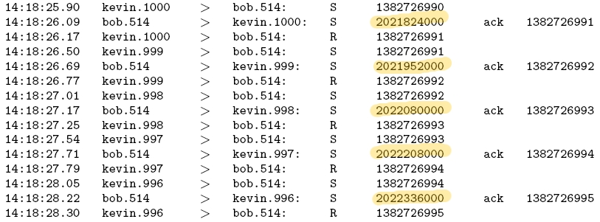
ISN Prediction
128,000
128,000
128,000
128,000

Slide 22
ARP Spoofing
Recall: ARP maps between IP addresses and hardware addresses
ARP is very simple and insecure
client: who knows the Ethernet address of 1.2.3.4?
anybody: 1.2.3.4 has Ethernet address 01:02:03:04:05:06
It is easy to forge responses (even non-solicited) to redirect traffic!
Notes:
Draw the picture with the gateway.

Slide 23
DNS Spoofing
Domain Name System maps names to IP addresses
DNS is a distributed system
Clients (e.g. the browser) contact a recursive nameserver
Recursive nameserver maintain a cache of previously resolved names
For a new request, the nameserver asks another server and recurses until an authoritative answer is found
An attacker can attempt to inject a false translation to a nameserver, and hence poison its cache
Exploit flaws in the DNS software
Flood a server with forged answers that guess the Query ID, a DNS packet field that uniquely identifies every request
A poisoned server can cause client traffic to be diverted to another computer, usually under control of the attacker

Slide 24
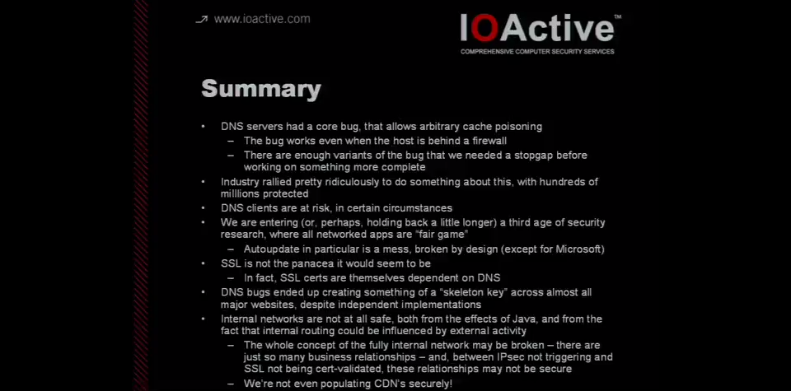
Extra
Watch Dan Kaminsky’s 2008 talk on an extremely serious vulnerability in DNS https://vimeo.com/17247507

Slide 25
Sniffing

Slide 26
Sniffing
Many protocols use clear text authentication
By eavesdropping traffic on a network segment, we can obtain usernames and passwords
A password gives access to a remote system from which we can sniff and obtain new passwords

Slide 27
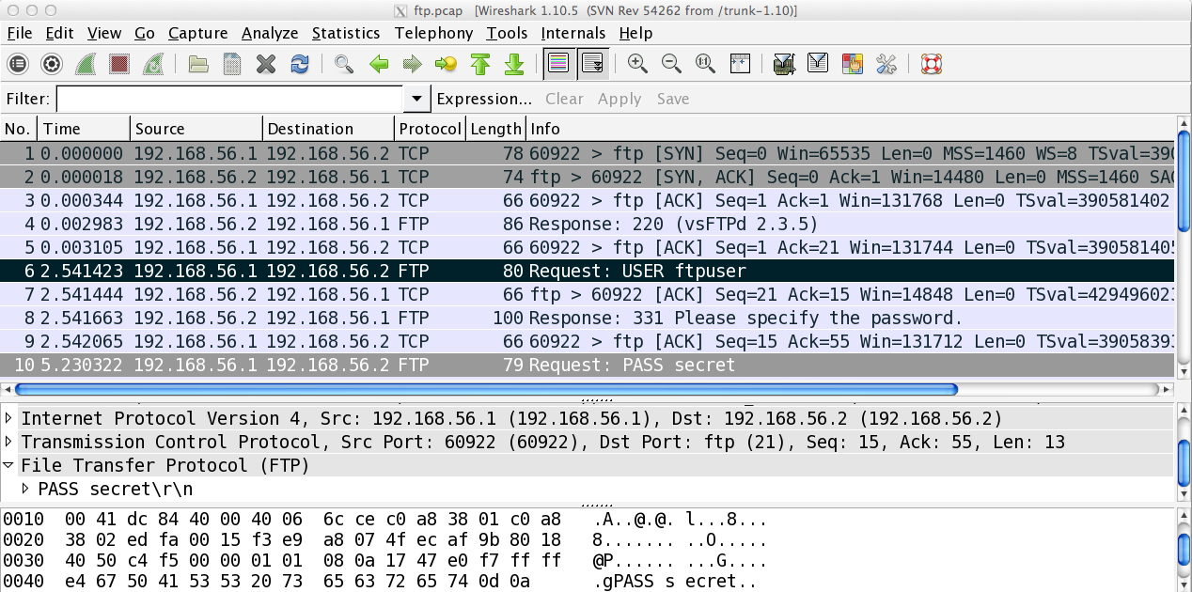
Sniffing Tool: Wireshark
Notes:
Do a demo with an FTP server

Slide 28
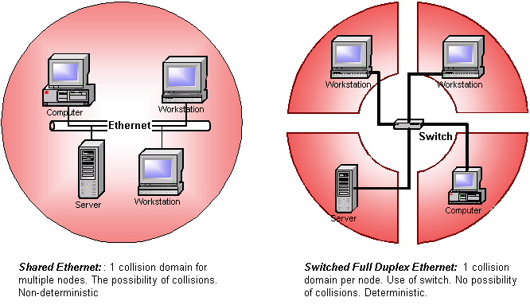
Sniffing
Switched networks limit sniffing possibilities, but switches can be manipulated
Source: Industrial Ethernet University

Slide 29
Session Hijacking

Slide 30
Session Hijacking
Instead of stealing a password, an attacker can wait until a user authenticates and then steal his session
This technique can be applied at several levels:
Modem
TCP
HTTP

Slide 31
Hijacking Modem Session
The modem gives access to a serial line
E.g. remote access
A user may drop the line without quitting the online session
The terminal’s session remains active for a while
The next user (or hacker) who connects to the modem finds the preceding user’s session

Slide 32
Hijacking TCP Session
If an attacker can spy on a TCP connection, he can insert a TCP packet with correct sequence numbers
Inserting an additional packet in a TCP connection creates a packet avalanche:
The source, who has never sent the packet, doesn’t agree with the acknowledged sequence number and emits an acknowledgement
The destination, who has seen the packet, insists on the sequence number and also sends an acknowledgement
An attacker can also take over the session, terminating the connection only on one end

Slide 33
Hijacking HTTP “Session”
HTTP doesn’t have the concept of a session
It is made of independent requests/responses
Websites use artificial means to recognize requests belonging to a session:
Cookies
Personalized URLs
If an attacker can spy on these data, he can create requests that would be part of the same session

Slide 34
Protection Against Session Hijacking
Encryption of data traffic (in particular session key)
Require two-factor authentication (e.g., via SMS)
Change the value of the cookie with each and every request, thus reducing the attack window
Use random session keys to prevent guessing

Slide 35

Denial of Service
Notes:
Source: http://finalphoenix.me/blog/2013/06/24/diy-how-to-ddos/

Slide 36
Denial of Service (DoS)
An attempt to make a machine or network resource unavailable to its intended users, either temporarily or indefinitely
Many methods of attack exist, classifiable as:
Consumption of computation resources (e.g. CPU, memory, bandwidth)
Disruption of configuration (e.g. routing information)
Disruption of state information (e.g. sending TCP RST packets)
Disruption of physical components
Obstructing communication media between the victim and its users
DoS attacks typically involve forged IP addresses

Slide 37
Historical example
Ping of death (PoD)
One of the earliest denial of service attack
Up to 1997, affected Unix, Linux, Mac, Windows, printers, and routers
Attack based on sending a malformed ICMP packet
Notes:
The IP packet is fragmented, and the bug is during the reconstruction of the packet once all the fragments are received.

Slide 38
Recall ICMP (Internet Control Message Protocol)
Collection of error & control messages
Sent back to the source when Router or Host cannot process packet correctly
Error Examples:
Destination host unreachable
Reassembly process failed
TTL reached 0
IP Header Checksum failed
Query Example:
Ping uses Echo Request/Reply to test the reachability of a host

Slide 39
Recall IP Fragmentation
0 4 8 16 19 31
Identification | Flags | Offset
Split datagram into fragments
Why? Maximum Transmission Unit (MTU) may vary for different networks
Each fragment is a complete datagram (own header)
Identification: uniquely identifying the group of fragments
Flags: all fragments except last have the MF flag set
Offset: relative to the beginning of the original unfragmented IP datagram
Receiving host reassembles them

Slide 40
Ping of death
Ping size is normally 56 bytes (84 with header)
Historically sending a ping larger than the maximum IPv4 packet size (65,535 bytes) could crash a target
How to send a packet large than maximum length?
Exploit fragmentation (problem has nothing to do with ICMP)
Maximum offset (13 bits) addresses 65,528 bytes
Send packet with maximum offset and more data than 8 bytes
When packet is reassembled, a buffer overflow can occur, which often causes a system crash
Prevented with stronger checks at receiver host
Notes:
The IP packet is fragmented, and the bug is during the reconstruction of the packet once all the fragments are received.

Slide 41
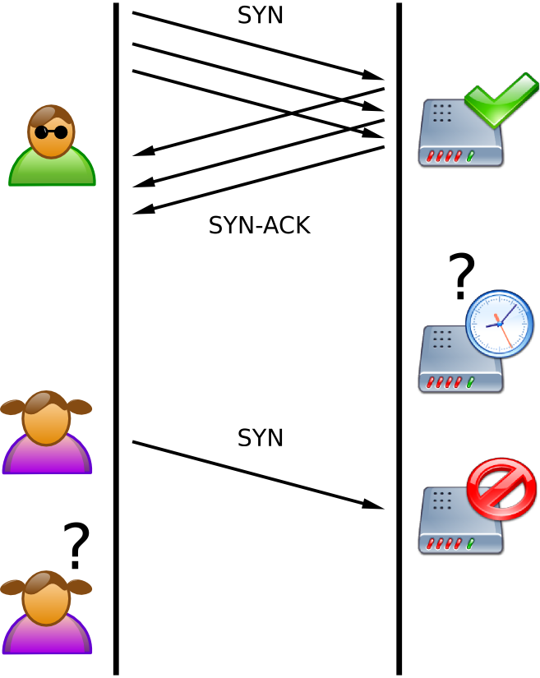
SYN Flooding
Send a large number TCP/SYN packets
Recall 3-way handshake: SYN ; SYN + ACK ; ACK
Source: Wikipedia

Slide 42
SYN Flooding
On receiving the SYN packet, the server allocates necessary memory for the connection and enters it in a queue of half open connections
Once the queue overflows, the server cannot accept any new connection
The attacker can forge the source address of his SYN packets to remain anonymous
Recent versions of operating systems (Windows, Unix, Linux) are protected against such attacks

Slide 43
Protections Against SYN Flooding
Increase the size of the queue
Reduce timeout while server is waiting for an ACK
Drop the oldest SYN in the queue
Filtering e.g. on IP addresses
SYN Cache
Allocate minimal state on the server, reply with SYN + ACK and complete the connection creation once the ACK is received
Host compute a hash based on some secrete bits, IP addresses and transport ports that determines the location in a global hash table where the incomplete connection information is stored
Still must be prepared to overflow
Notes:
Increase the queue size put forward the problem. Moreover, increasing the queue size consumes memory.
The shorter timeouts can also be a source for trouble. While 25 seconds appears to be a safe value (if it takes more than 25 seconds to exchange one pair of packets, maybe you should try again later), people coming from dial-up connected systems might be excluded. If a smaller value, such as ten seconds, is chosen, you will very likely be excluding sites connected via PPP, SLIP and modems.
Filtering on IP addresses: if an IP address does not send an ACK, then drop the subsequent SYN request coming from this address.

Slide 44
Protections Against SYN Flooding
SYN cookies
Once the connection queue is almost filled up, the server uses SYN cookies
Upon reception of a SYN:
The server sends a SYN + ACK containing a SYN cookie
The server erases the SYN entry
Upon reception of an ACK:
The server checks whether it contains a valid cookie
If so this highly likely means that the client has already sent a SYN and so it is an honest client

Slide 45
SYN Cookie Content
SYN cookies are specific Initial Sequence Numbers:
t is a counter incremented every 64 s modulo 32
m is the Maximum Segment Size encoded on 3 bits
s is the result of a cryptographic hash function computed on t and the IP address and port number of the server and client
ISN = | t mod 32 | m | s
 | 5 bits | 3 bits | 24 bits
 | 32 bits
Notes:
“In order to initiate a TCP connection, the client sends a TCP SYN packet to the server. In response, the server sends a TCP SYN+ACK packet back to the client. One of the values in this packet is a sequence number, which is used by the TCP protocol to reassemble the data stream. According to the TCP specification, that first sequence number sent by an endpoint can be any value as decided by that endpoint. SYN Cookies are initial sequence numbers that are carefully constructed according to the following rules:
let t = A counter incremented every 64 seconds
let m = The maximum segment size (MSS) value that the server would have stored in the SYN queue entry
let s = The result of a cryptographic secret function computed over the server IP address and port number, the client IP address and port number, and the value t. The returned value "s " must be a 24-bit value.
The initial TCP sequence number, i.e. the SYN Cookie, is computed as follows:
First 5 bits: t mod 32
Next 3 bits: an encoded value representing m
Final 24 bits: s
(Note: since m must be encoded using 3 bits, the server is restricted to sending up to 8 unique values for m when SYN Cookies are in use.)
When a client sends back a TCP ACK packet to the server in response to the server's SYN+ACK packet, the client MUST (according to the TCP spec) use n+1 in the packet's Acknowledgement number, where n is the initial sequence number sent by the server. The server then subtracts 1 from the acknowledgement number to reveal the SYN Cookie sent to the client.
The server then performs the following operations.
Checks the value t against the current time to see if the connection is expired.
Recomputes s to determine whether this is, indeed, a valid SYN Cookie.
Decodes the value m from the 3-bit encoding in the SYN Cookie, which it then can use to reconstruct the SYN queue entry.
From this point forward, the connection proceeds as normal.” (Source: Wikipedia)
MSS is the Maximum Segment Size. Since m is encoded on 3 bits, a table containing the most common MSS is stored by the server and m is an index in this table.

Slide 46
SYN Cookie Check
Upon reception of an ACK, the server carries out the following operations:
Check that the received value t is valid with respect to the current time
Otherwise, this means the connection is expired
Recompute s to check its validity
Decode the value m, which allows the server to reconstruct the SYN queue entry

Slide 47
Smurf Attack
Drown the target with the help of traffic amplifiers
Typical case: ICMP Echo Request (ping)
The attacker sends a ping packet with the target address as source address
The target machine sends its response to the victim
If the attacker sends the packet to a broadcast address, all machines in the network will reply to the victim

Slide 48
Smurf Example
ICMP Echo Replies
Victim
LAN
Host
Internet
IP: 3.3.3.3
LAN
Host
ICMP Echo Request Source (spoofed): 3.3.3.3 Destination (broadcast): 2.2.2.255
Real IP: 1.1.1.1
LAN
Host
Attacker

Slide 49
Protections Against Smurf Attack
Configure individual hosts and routers not to respond to ping requests to broadcast addresses
Configure routers not to forward packets directed to broadcast addresses
Traffic amplification is more effective when application replies are much larger than requests

Slide 50
DDoS: Distributed Denial of Service
To increase the efficiency of Denial of Service, attackers hack into several machines and install agents on them to form a botnet
Several master machines control the botnet
The attacker sends commands to the masters which in turn execute the attack through the agents

Slide 51
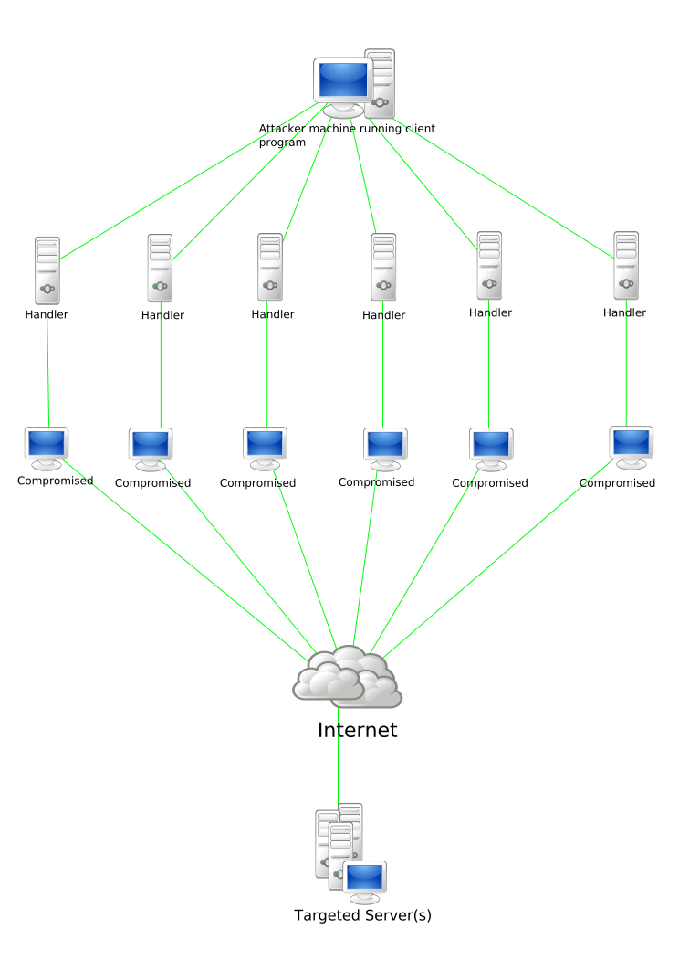
DDoS: Architecture
Source: Wikipedia
Notes:
Ask what a DoS is.

Slide 52
DDoS: Characteristics
The power (bandwidth) of the attack is multiplied by the agents
It is more difficult to trace the attackers
2 intermediate layers
Encrypted control traffic (even peer-to-peer)
Since attack comes from several sources, it is much more difficult to filter it

Slide 53
DDoS Recent Examples
Mar 2013 – DDoS attack against Spamhaus
reportedly the largest in history, peaked at 300 Gbps [CloudFlare]
Oct 2012 – HSBC experienced a downtime of many of its website worldwide
Aug 2012 – WikiLeaks was hit by a DDoS attack
Jun 2012 – CIA website fallen foul of a DDoS attack
Mar 2011 – WordPress.com suffered an extremely large DDoS attack
Nowadays thousands of hacked WordPress websites are used to carry out DDoS attackes

Slide 54
Any questions?

Slide 55

Firewalls
Stay tuned
Next time you will learn about
Notes:
Source: http://info.netcenter.net/Portals/192612/images/firewall2.jpg

